Slide 1
Year 10 PreATAR Science
DNA and Inheritance:
Cells

Slide 2
Review…
Which type of graph would you use to show…?
Continuous data
Grouped data
Discrete data/non-numerical data
2. Explain what is meant by a line of best fit.
3. What is extrapolation?

Slide 3
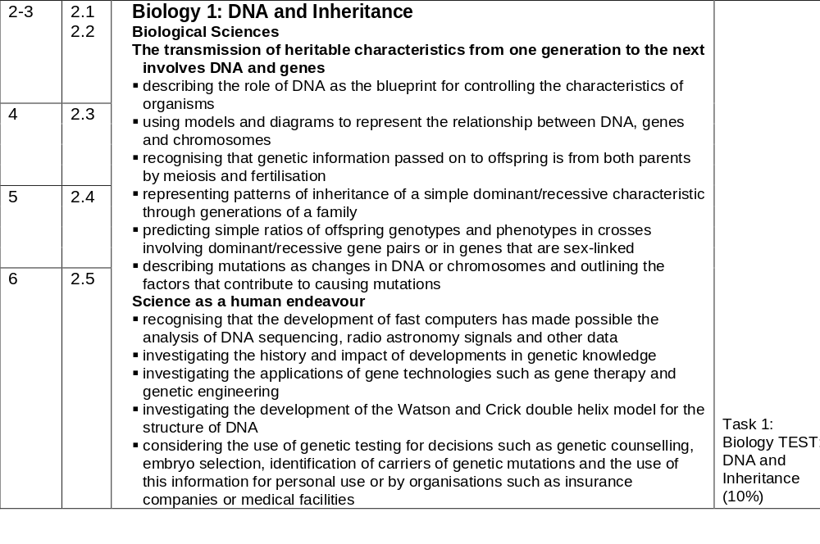
Topic Preview

Slide 4
Learning Intentions
Relate the structure of cells and their organelles to their functions.

Slide 5
Success Criteria
Label a diagram of a cell
Describe the function of organelles
Relate the structure of organelles to their function
Identify organelles which are involved in cell replication and protein synthesis

Slide 6
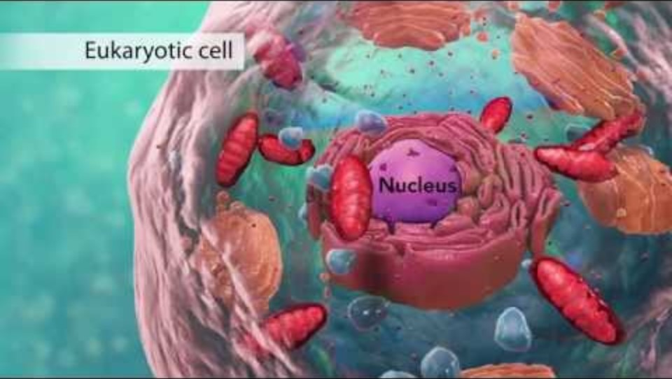
Cells

Slide 7
Worksheet: Cells and their organelles

Slide 8
Success Criteria
Label a diagram of a cell
Describe the function of organelles
Relate the structure of organelles to their function
Identify organelles which are involved in cell replication and protein synthesis

